Slide 1
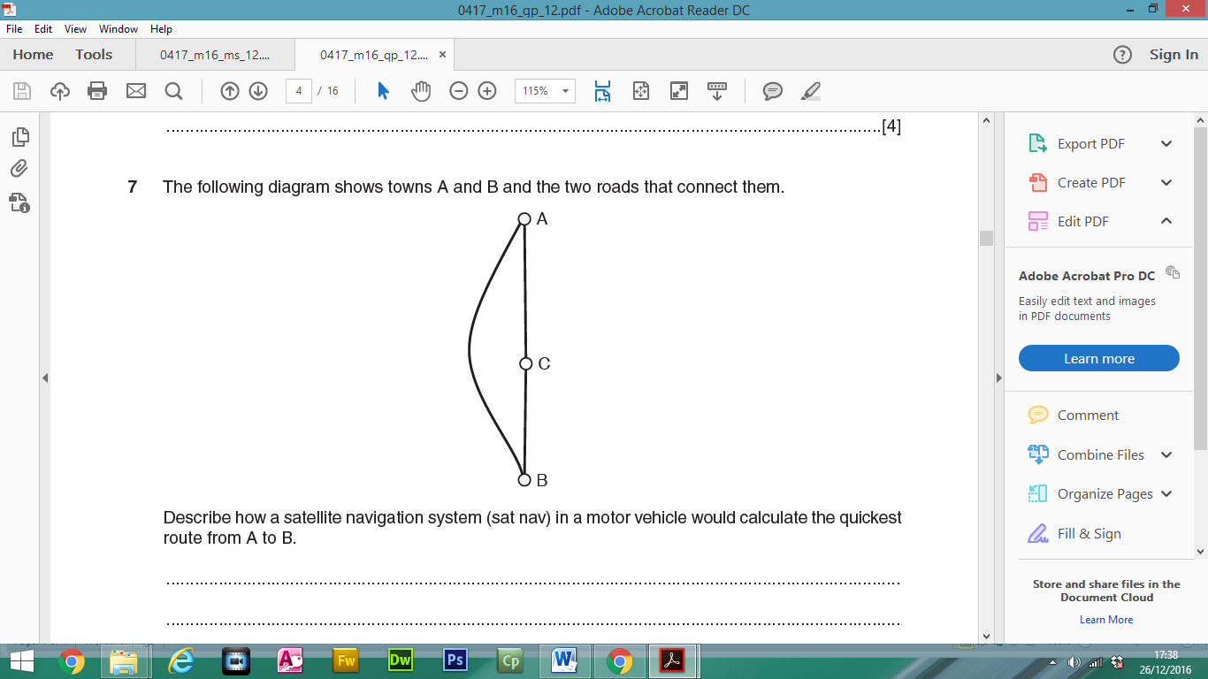
The following diagram shows towns A and B and the two roads that connect them.
Describe how a satellite navigation system (sat nav) in a motor vehicle would calculate the quickest route from A to B.
Destination B is input by driver
Position of motor vehicle at A is calculated using GPS …using data transmitted from 3/4 satellites
Algorithm calculates shortest distance from A to B (going through C)
Algorithm calculates distance from A to B not going through C
Makes allowances for traffic in town C and takes into account average road speeds… using traffic/speed sensors on roads
Takes into account regular updates of traffic conditions
Takes into account max. speed on the road/type of road

Slide 2
In certain countries, the RFID chip in a passport is scanned when the passport is presented at an automated passport control gate.
Give three items of information about the passport holder that are stored on the RFID chip.
Name
Passport number
Date of birth
Place of birth
Nationality
Issue date
Expiry date
Facial characteristics/photograph/fingerprint/retina scan
Biometric measurements (face)
Signature
Gender
Place of issue

Slide 3
Describe how RFID technology reads the details from the chip.
The chip is presented near a computer with a radio-frequency scanner
The scanning antenna puts out radio-frequency signals in a relatively short range.
It provides a means of communicating with the transponder/the RFID tag
The scanning device provides energy…
…so that the chips can broadcast the information in them…
…for the computer to read.
Explain why RFID technology is used for reading data from passports.
More secure than a traditional passport as biometric measurement data difficult to forge
Counterfeits can be more easily identified than non-RFID passports
More rapid flow at security check points/quicker than reading it manually

Slide 4
“Chip and PIN is the new, more secure way to pay with credit or debit cards ”.
Discuss the accuracy of this statement with regard to developments, since and including the use of magnetic stripe cards at EFTPOS terminals and ATMs.
Examples of more secure:
Even when the card is stolen, the thief still needs the PIN, so it is much safer
Data more difficult to copy
Larger amount of information can be stored
Disabled people find it easier than signing
Reduces disputes at checkouts over validity of signature/Saves time at checkouts
Not affected by magnetic fields
If the transaction did not take place near a terminal (in a restaurant, for example) the card had to be taken away from the customer to the card machine.
Even at the terminal, the criminal could bend down in front of the customer and swipe the card on a hidden reader.
Illegal cloning of cards easy, and a common occurrence.

Slide 5
“Chip and PIN is the new, more secure way to pay with credit or debit cards ”.
Discuss the accuracy of this statement with regard to developments, since and including the use of magnetic stripe cards at EFTPOS terminals and ATMs.
Examples of not always secure because:
Cards can still be cloned
People can be careless when using their PIN.
Credit and debit card fraud has gone down with chip and pin
ATM fraud has gone up.
Hidden cameras sometimes are used to see which keys are pressed for the PIN.
The advent of chip and pin has also generated a rise in phishing

Slide 6
A school has introduced a system so that parents of its students can access data about their children.
Give three reasons why the school has introduced this system.
To save printing costs of reports
To ensure test results, etc. are received by parents
To allow immediate feedback to parents after tests/exams
To keep parents up to date with child’s progress/targets

Slide 7
Give three specific examples of work that are carried out by a robot in the car industry.
Putting wheels on cars
Painting car bodies
Welding parts on a car body
Carrying car windscreens/doors
Moving goods in an automatic warehouse
Placing engine block into body
Installing transmission system

Slide 8
Give three reasons why it would not be sensible to use batch processing in an online theatre booking system.
It might lead to double booking
Customer would not be sure booking has been successful
Would take a long time to receive confirmation/ticket
Processing would take a long time which would cost company money

Slide 9
A chemistry student wants to measure how quickly a liquid cools after it has boiled. She will use a sensor connected to a computer to do this.
Identify two variables which will need to be recorded.
Temperature & Time
Describe how the computer would process the data into a form the student could use to analyse the results.
The sensor feeds back data to computer
Data is converted from Analogue to Digital
Readings are stored in a spreadsheet/software package
Graphs are automatically produced by computer…
...plotted against time
Calculations performed on spreadsheet to show rate of cooling
Graphs examined to see general overview of rate of cooling

Slide 10
Most supermarkets now operate online shopping.
Discuss the advantages and disadvantages to supermarkets of this development.
Initial cost of hardware/software is expensive
Fewer staff needed – less spent on wages
Fewer shops needed – less spent on rates/rent/utilities
Potentially larger customer base
Need to retrain staff
Less customer loyalty/loss of customers/more difficult to sell other services/products due to lack
of personal touch
Costs of system maintenance
Greater costs due to more delivery staff/vans

Slide 11
Describe three benefits to customers of using internet banking.
Save travelling expenses
Saves time travelling/queuing
Elderly/disabled people don't have to travel
No embarrassment having to ask for loans face to face
Can bank when banks are closed
Use it anywhere there's an internet connection

Slide 12
Financial models and scientific experiments are examples of different types of modelling applications.
Give three other examples of types of modelling.
Simulations
Mathematical models
Civil engineering models
Flight/pilot simulation/training
Design of fairground rides
Traffic control
Building fire simulation
Weather forecast models
Population modelling

Slide 13
A ferry connects two countries. When car drivers approach the ferry they have to check in to confirm the details they have already booked. If they drive in to the self check-in lane, details of the car are automatically input to a computer.
The terminal which is used for the driver to identify themselves produces a personalised welcome message on a screen. There is a database which contains details of the driver and the car.
Write down the data which is automatically input to the computer.
The car registration number
Other than your answer to (a) give two items of data stored in the computer database.
Car owner's name
Car driver's name
Height/ Length of vehicle
Colour of vehicle
Credit/debit card details
Make of car/model of car

Slide 14
Explain how Optical Character Recognition is used before the computer processes the data.
As the car arrives a camera takes a snapshot of the number plate as an image
Stores it in a file
Software identifies where number plate is in image and crops that part of the image
The OCR software converts the registration number to numbers/letters
Explain the computer processing which takes place to produce the personalised message.
The number plate is compared…
…with those stored on the customer file
When a matching record is found
The name of the customer is read
The name is merged into the message
And a signal is sent to screen to display the appropriate part of the message

Slide 15
Explain what is meant by VOIP.
Voice over Internet Protocol
A set of rules that enable people to use the Internet to make telephone calls/talk each other
Sends voice data in packets using IP
Name two items of computer hardware that are needed in order to make a VOIP phone call from one computer to another.
Microphone
Speakers/headphones
Headset

Slide 16
A customer wishes to check the balance of their bank account and inserts their card into the ATM.
Describe the computer processing which takes place at the ATM.
The bank account details are read from the chip
The (ATM) checks to see if the card is valid
The customer is asked which language/currency they require
The customer is asked to type in their PIN
The typed PIN number is compared with that stored in the chip…
…if they are the same the transaction proceeds
…if they are not the same the customer is asked to re-enter PIN
If three failed attempts transaction rejected and card withheld
The customer is asked which service is required
Customer is asked if they want a printed balance/onscreen balance
If yes, signal sent to print balance/message sent to screen giving balance
The customer is asked if further services are required

Slide 17
A customer wishes to check the balance of their bank account and inserts their card into the ATM.
Describe the computer processing which takes place at the bank’s computer.
Checks whether card is stolen/account number exists
Customer account number is searched
Balance field is read/is calculated
Message sent to ATM giving balance

Slide 18
When a bank cheque is presented to a bank it is sent off to a cheque clearing centre.
Give three items of information that are pre-printed on the cheque in magnetic ink.
Account number
Bank/branch sort code
Cheque number
Describe how MICR is used to read these details from the cheque.
Requires a special Magnetic Ink Character reader/scanner/Details are scanned
The magnetic ink on the cheque passes over a magnet in the reader/scanner which
charges/magnetises the ink
The MICR reader/scanner then reads the magnetic signal given out by the magnetic ink
characters on the cheque.
Each character produces a unique signal which is read and translated by the MIC reader
Explain why magnetic ink is used rather than bar codes on a cheque.
More difficult to forge
Even if overwritten/damaged can still be read by computer
Information is human readable

Slide 19
Identify four uses of online booking systems.
Air flight tickets
Theatre tickets
Holiday booking
Cinema tickets
Rail tickets
Hotel room booking
Restaurant table/seat booking
Football match booking
Concert/performance booking

Slide 20
A school library uses a computer system where there is a book file and a borrower file. Each student has a unique membership number and each book has a unique accession number.
The accession number is the number given to a book when it is first bought by the library. When a book is borrowed, the student has their thumbprint read by a special input device.
Describe the computer processing involved when a book is borrowed.
The books database is searched to find the accession number
The fingerprint scan is converted into digital data patterns
The computer then maps points on the fingerprints and uses those points…
…to search for similar patterns in the (borrower) database.
Matching record is found
The membership number is retrieved
Record is checked to see if number of books allowed is not exceeded/are fines due?
The membership number is written to the file against the accession number in the books database
The accession number is written against membership number in the borrower file.

Slide 21
A school library uses a computer system where there is a book file and a borrower file. Each student has a unique membership number and each book has a unique accession number.
The accession number is the number given to a book when it is first bought by the library. When a book is borrowed, the student has their thumbprint read by a special input device.
Describe the computer processing involved when a book is returned. There is no need for the borrower to have their thumbprint read during this process.
Accession number is compared with those on book file
Matching record is found
Record is flagged as returned/changed to returned
The accession number is deleted against membership number in the borrower file/borrower
is recorded as having borrowed one less book
Computer calculates if book has been returned overdue

Slide 22
When customers use phone banking they are connected to an automated system.
Give two items of data they are asked to key in to identify themselves to the system.
Sort code
Account/bank card number
3 digits from password/passcode
Memorable date/mother’s maiden name/favourite place/answer to security question/place born
Date of birth
Identify three services that they can use in phone banking.
Transfer money to a different account or between accounts
Pay bills or amend/create standing orders/direct debits
Order a new PIN
Stop a cheque
Can ask about recent/pending transactions
Can apply for a loan
Can check account balances
Can amend personal details

Slide 23
A student exam answer sheet consists of boxes or lozenges which the student shades in to indicate their choice of answer.
Apart from the details of the test and the lozenges, give two items of information, essential to the student, that are pre-printed on the answer sheet.
Student id number/prompts for student number
date of birth
student name
Instructions on how to complete the form
Question numbers
Centre number
Centre name
Describe how Optical Mark Recognition is used to process the details from the form.
Dedicated scanner device shines a beam of light onto the form
Light is reflected back to sensors
Marks reflect less light so sensors used to identify position of marks
Computer compares these with correct answer positions

Slide 24
A student exam answer sheet consists of boxes or lozenges which the student shades in to indicate their choice of answer.
Describe the drawbacks of using Optical Mark Recognition
If the marks don't fill the space completely they may not be read correctly/overfill the space/smudged
If the marks are not in a dark enough pencil they may not be read correctly
If more than one lozenge shaded in result is invalidated
Only suitable for recording one out of a selection of answers, not suitable for text input
Have to use prepared forms which may be expensive
Examinations could consist of mainly multiple-choice questions changing the nature of what is being tested

